Slide 1

What does the mobile map interactions look like in navigation trajectories?
Author: Zhengfang Xu
Supervisor: Prof. Dr. Sara Irina Fabrikant
Dr. Mona Bartling

Slide 2
Intro
Research Question
Data
Method
Timeline
Research Aim
Evaluate adaptation map strategies in association with dynamic context
Map use context
Adaptive map design
Information that characterizes a map use situation, including information on the user, the environment, activity, and the map itself. (Griffin et al., 2017)
Various contextual factors need adjustments to the map design.

Slide 3
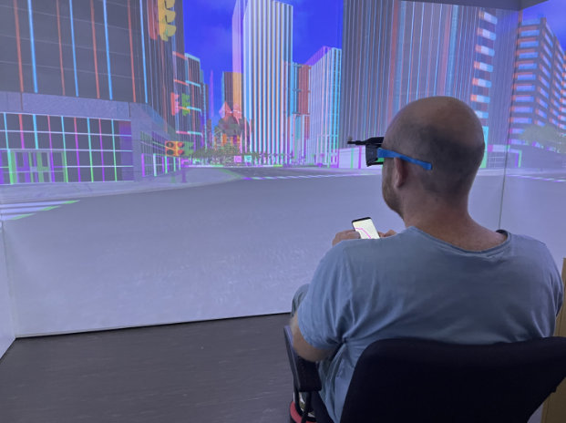
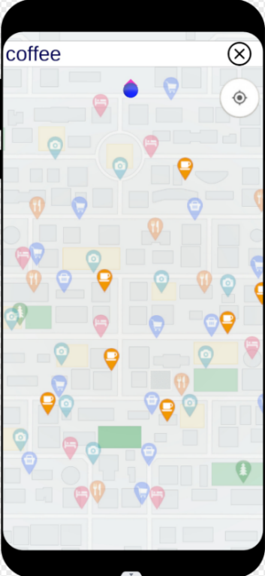
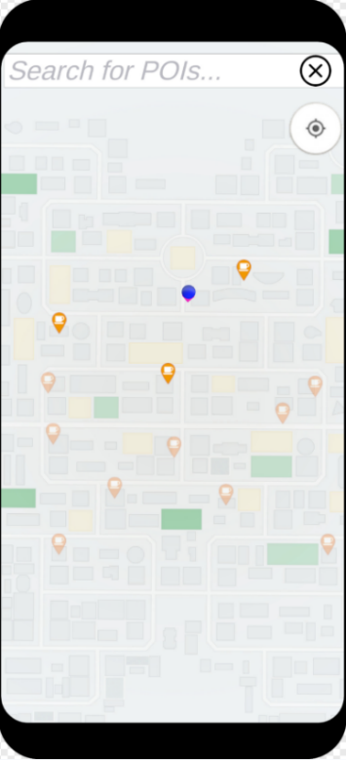
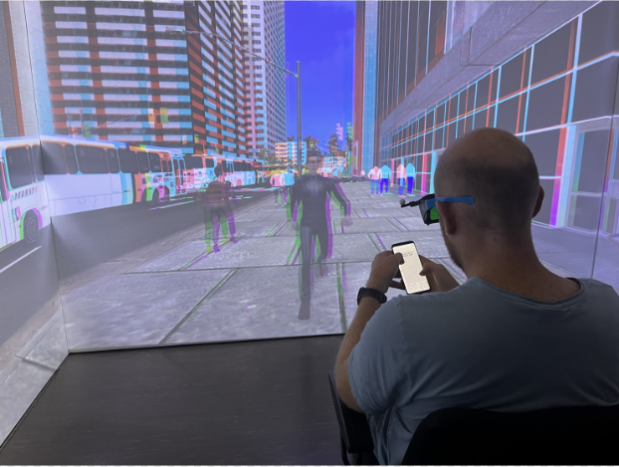
Intro
Research Question
Data
Method
Timeline
Experiment Design
Traffic densities
Adaptation type
Light density
4 Experiment Scenarios from 2x2 factorial within-subjects
No-adaptive
Adaptive
 | Traffic density | Adaptation type
Scenario 1 | Low | Null
Scenario 2 | Low | Adapted
Scenario 3 | High | Null
Scenario 4 | High | Adapted
Heavy density
Adaptative map:
Mask the icons no-task-related with task automatically
3 nearest task-related icons are highlighted
Light : Heavy = 1:30

Slide 4
Intro
Research Question
Data
Method
Timeline
Experiment Procedure:
Participant(54):
Age :
54% aged 25–34,
43% aged 18–24.
Gender:
61% Female.
39% Male.
Map use frequency:
67% more than four times a week.
28 between two and four times a week.
Spatial ability:
Average SBSOD score for all participants: 4.49 (1=poor, 7=good), with a standard deviation of 1.1.
Different story line of each scenario：
e.g: Visiting a friend.
4 Navigation tasks of each scenario:
e.g: participants were asked to go to a supermarket as their friend asked them to buy Suga.
Freedom:
Free to choose to which specific POI they wished to go.
Time restriction:
As efficient as possible (Navigation aim)

Slide 5





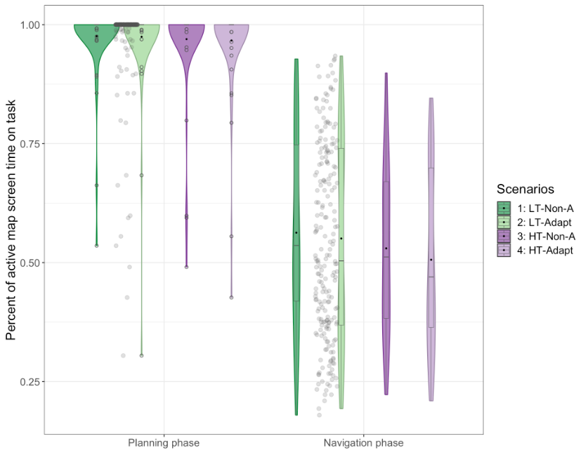



Intro
Research Question
Data
Method
Timeline
Definition: Planning and Navigating phase
Planning: From taskAccept to setNavigationTarget
Navigating: From setNavigationTarget to checkedIn(finish task)
Finding: Map Interactions in navigation
Finding: ScreenLock Time in navigation
Approximately 47% of the navigation time is spent in the screen lock state.
Panning 45%
Unlock 20%
Zoom 10%
Rotate 5%
Show last message 3%
Others 17%

Slide 6

Intro
Research Question
Data
Method
Timeline
Research Question
How are map interactions distributed within the navigation trajectory?
How is the screen lock/unlock phase distributed within the navigation trajectory?
How do context and individual factors influence the distribution of map interactions and screen lock/unlock phases within the trajectory?

Slide 7
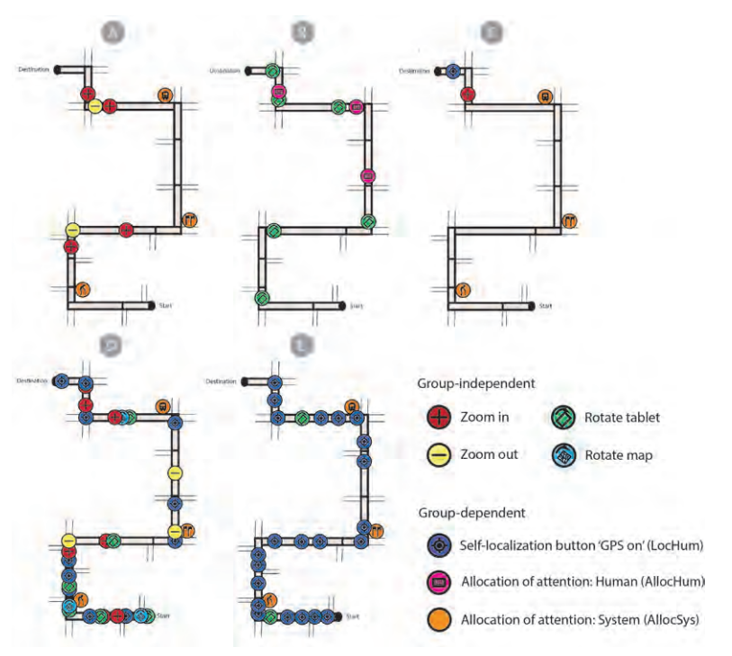
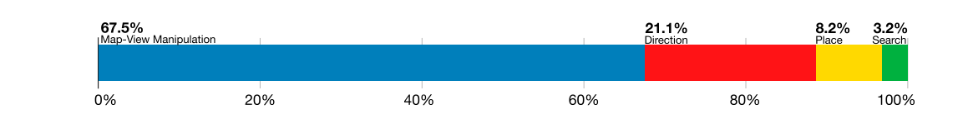
Intro
Research Question
Data
Method
Timeline
How are map interactions distributed within the navigation trajectory?
Webber et al. (2012) identified three distinct strategy groups. Brügger Annina (2020) categorized participants' interactions into five distinct types of behaviors and depicted the distribution in a predetermined route in Fig1.
Savino et al. (2021) used MapRecorder to analysis how mobile map are used in real world. They found map interactions state in Fig 2. However, they mentioned Google Maps navigation could not be tracked.
Fig 2 by Savino et al. (2021)
Fig 1 by Brügger Annina (2020)

Slide 8
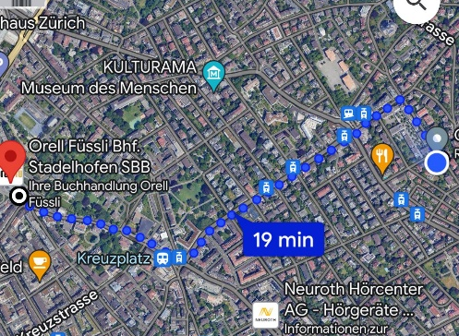
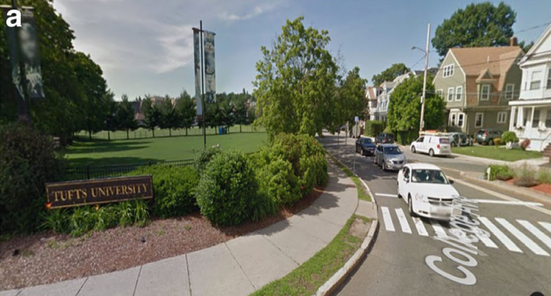
Intro
Research Question
Data
Method
Timeline
How is the screen lock/unlock phase distributed within the navigation trajectory?
Dai et al. (2018) Environment learning can be achieved through map study or through direct experience with the environment.
Map Study(check map in navigation)
Route Experience(without map checking)
Metacognition
Monitor&Control
Less studies on switching or combining Map Study and Route Experience.
Map Study = Screen unlock
Route Experience= Screen lock

Slide 9
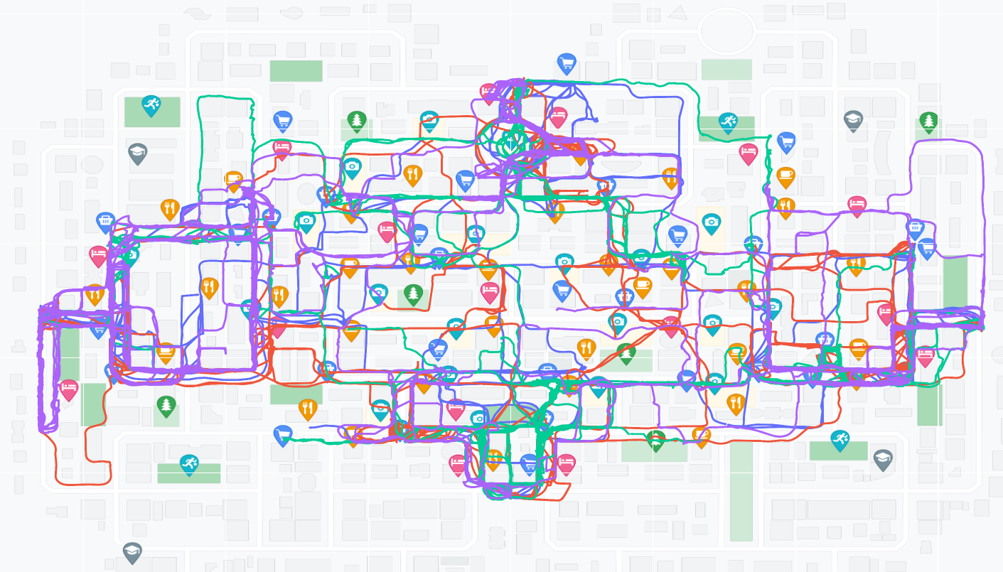
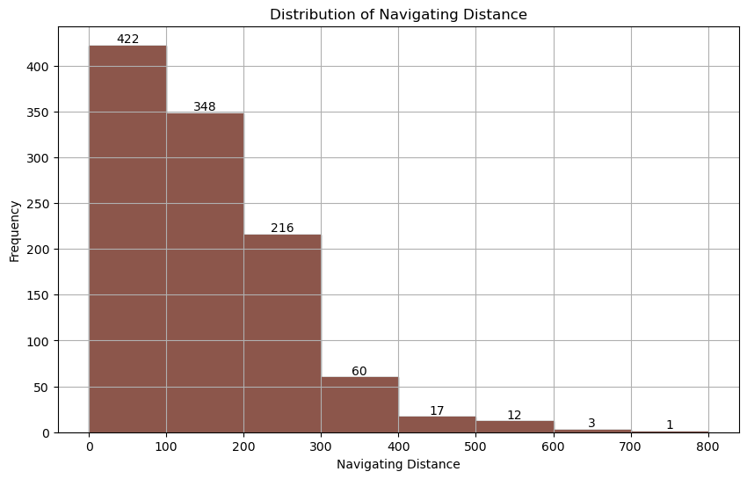
Intro
Research Question
Data
Method
Timeline
Trajectory: 863

Slide 10
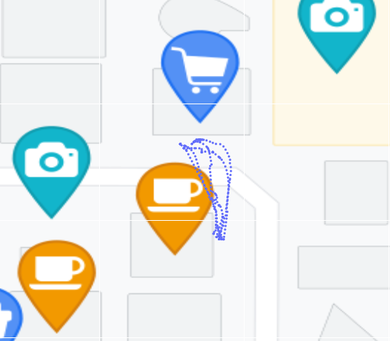
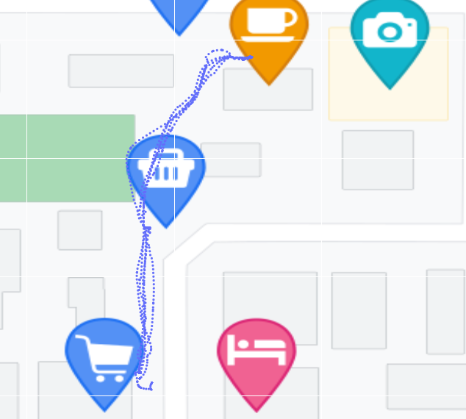
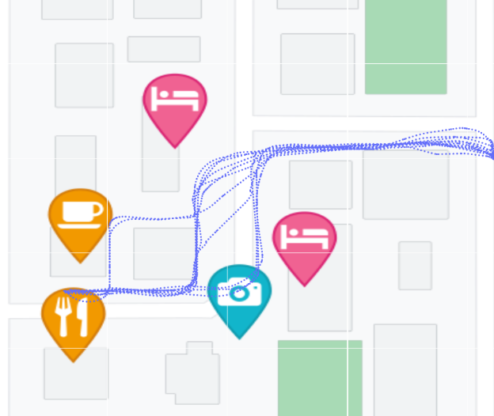
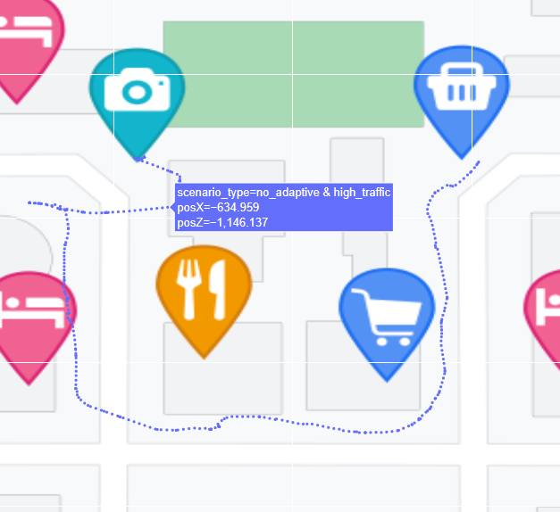
Intro
Research Question
Data
Method
Timeline
50 units
150 units
250 units
350 units
Interactive Visualization

Slide 11

Intro
Research Question
Data
Method
Timeline
Method
Trajectory classification.
K-means clustering
DBSCAN
Decision trees
Random forests ……
Trajectory normalization.
Translation: Moving trajectories to a common origin or reference point.
Rotation: Rotating trajectories to align them with a common orientation or axis.
Scaling： Rescaling trajectory coordinates to a common range
Analyze and visualize mapInteraction and lock/unlock information in trajectory.

Slide 12
Intro
Research Question
Data
Method
Timeline
1 Feb. 2024
Start of master thesis
16 Apr. 2024
Concept talk
31 May 2024
Trajectory Classification
15 June 2024
Trajectory Normalization
15 July 2024
Mapinteractions and Screen lock/unlock analysis and visualization
31 Aug. 2024
Thesis writing
30 Sep. 2024
Submission of the Master’s Thesis
1 Nov. 2024
Master’s Exam

Slide 13
Reference:
Webber, E., Burnett, G., & Morley, J. (2012, September). Pedestrian navigation with a mobile device: strategy use and environmental learning. In The 26th BCS Conference on Human Computer Interaction. BCS Learning & Development.
Brügger, Annina. (2020). Title Walk and learn: effects of human-centered navigation systems onpedestrians’ navigation behavior Doctoral dissertation, University of Zurich,
Savino, G. L., Sturdee, M., Rundé, S., Lohmeier, C., Hecht, B., Prandi, C., ... & Schöning, J. (2021). MapRecorder: analysing real-world usage of mobile map applications. Behaviour & Information Technology, 40(7), 646-662.
Dai, R., Thomas, A. K., & Taylor, H. A. (2018). When to look at maps in navigation: metacognitive control in environment learning. Cognitive Research: Principles and Implications, 3, 1-12.
Bartling, M., Resch, B., Reichenbacher, T., Havas, C. R., Robinson, A. C., Fabrikant, S. I., & Blaschke, T. (2022). Adapting mobile map application designs to map use context: a review and call for action on potential future research themes. Cartography and Geographic Information Science, 49(3), 237-251.
Lakehal, A., Lepreux, S., Letalle, L., & Kolski, C. (2021). From wayfinding model to future context-based adaptation of HCI in Urban Mobility for pedestrians with active navigation needs. International Journal of Human–Computer Interaction, 37(4), 378-389.
May, A. J., Ross, T., Bayer, S. H., & Tarkiainen, M. J. (2003). Pedestrian navigation aids: information requirements and design implications. Personal and Ubiquitous Computing, 7, 331-338.

